Slide 1

Progress Seminar on Freelancing Website
Presented By
PRANAV PURKAR
Guided By
Ms. ROSHANI TALMALE
Department of Computer Science & Engineering
S. B. JAIN INSTITUTE OF TECHNOLOGY MANAGEMENT AND RESEARCH,NAGPUR
An Autonomous Institute, Affiliated to RTMNU, Nagpur
S. B. Jain Institute of Technology Management and Research
1

Slide 2
Contents
Problem Statement & Objectives
Introduction
Literature Survey
Use Case Diagram
System Design
Technology to be Used
Modules
Advantages & Applications
Future scope
Conclusion
References
2
S. B. Jain Institute of Technology Management and Research

Slide 3
Problem Statement & Objectives
Problem Statement
As we all know that due to pandemic covid-19 , it affected each and every day- to- day activities and mainly it has affected the financial conditions of many employees who are working in any firm or are running their own businesses . Many peoples lost their jobs (in spite of having skills). So to support their family they don’t have any source of income in this period of recession when fetching job is a tedious task to do.
Objectives
To provide a stage where user can earn by showing their skills.
To provide a user friendly workplace from the comfort of home.
To provide flexibility in the choices of the skillsets.
To provide a better work-life balance.
3
S. B. Jain Institute of Technology Management and Research

Slide 4
Introduction
This project is based on freelancing , In this initiative those who have lost their jobs and are searching to start a career can grab this opportunity as a source of income and to explore oneself in the era of digital world by sitting comfortably at home. One can find many options such as (Game-development, web-development ,video-editing ,Digital-marketing etc).
there are many more other options available and if the user has the required skillset then they can earn as much as they can. This can be a great platform to improve the skills and grow. If the user have any queries then they can also reach to us via a contact form that is available on the site.
S. B. Jain Institute of Technology Management and Research
4

Slide 5
Literature Survey
Websites / Paper / Article | Reviews / Findings
1)Upwork.com | It is a freelancing website where user can earn by using their skills and also customers can hire freelancers according to their needs.
2)Guru.com | It is a freelancing website since 1998 . It's works to simply provide a platform where Employers and Freelancers can work together
S. B. Jain Institute of Technology Management and research
5

Slide 6

Use case Diagram
LOGIN OR SIGNUP
FILL FEEDBACK FORM
ABOUTUS
HOME
USER
EXPLORE SKILLS
S. B. Jain Institute of Technology Management and research
6

Slide 7
SYSTEM DESIGN : FLOW CHART
START
LOGIN
SIGNUP
Game dev.
Web dev.
Graphic designing
Video Editing
Sketching
STOP
S. B. Jain Institute of Technology Management and research
7

Slide 8
Technology to be Use
Front End:
CSS, HTML
IDE: Visual Studio Code
S. B. Jain Institute of Technology Management and research
8

Slide 9

Modules
USER MODULE :
Home Page.
User can explore various options from here.
S. B. Jain Institute of Technology Management and Research
9

Slide 10

USER MODULE :
Sign up via Gmail or Facebook account.
If “Already a user” the click on the yellow hyperlink it will redirect you to the login page.
S. B. Jain Institute of Technology Management and Research
10

Slide 11

USER MODULE :
User can login into their account.
After clicking the login button user will be redirected to the home page.
They can explore skills.
S. B. Jain Institute of Technology Management and Research
11

Slide 12
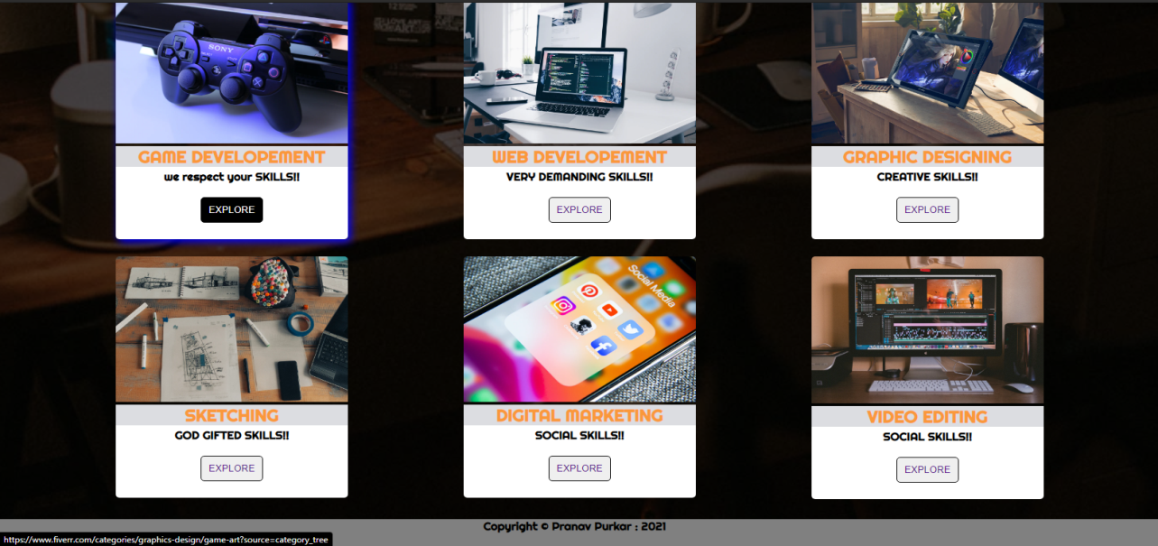
Skills Module:
Game development
Web development
Graphic designing
Sketching
Digital marketing
Video Editing
S. B. Jain Institute of Technology Management and Research
12

Slide 13

User Module:
User can give their valuable feedbacks.
It will help us to improve the project more
S. B. Jain Institute of Technology Management and Research
13

Slide 14
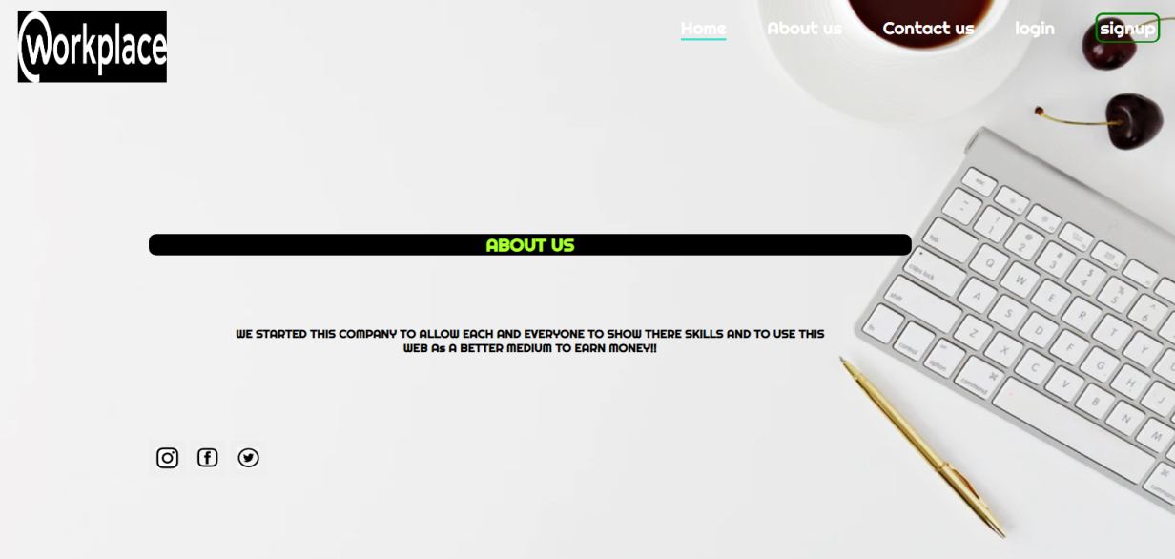
About us module:
User can connect with us on social media.
S. B. Jain Institute of Technology Management and Research
14

Slide 15
Advantages & Applications
ADVANTAGES:
Flexibility In Choosing The Skill Set : Users have the choice to select the skillset in which they are comfortable and confident to work in.
Offer work-life balance. Freelancers working from home can save this time and instead it spend it on doing additional work to earn more money. Likewise, freelancers can opt to work at their own pace and do only as many projects as they wish. They can complete their tasks anytime during the day or night. In many big cities, commuting from home to office takes up a lot of time.
No – Investment : The biggest advantage of this project is that it just gives and not takes anything from the users other than their time.
APPLICATIONS:
Anyone from across the globe can use it .
Used as a source of income.
S. B. Jain Institute of Technology Management and Research
15

Slide 16
FUTURE SCOPE
FUTURE SCOPE :
In future , more skills can be added to this project so that more peoples will get benefitted from it. And there will be a great opportunity for the existing and upcoming firms to hire well skilled employees for there companies.
S. B. Jain Institute of Technology Management and Research
16

Slide 17
CONCLUSION
I have entirely completed my project , and my project is designed to give a source of income to those who have skills and those who unfortunately lost their jobs due to this pandemic situation . In this project users can sign up with just one click and can explore whichever skill they are comfortable in . When they explore some skills then a page displaying all the work related to their skill will show off , from there they can select according to their interest. And similarly they can work on their other skills (as there are more options) and in future more options can be added.
During the development of this project I understood the importance of individual work while project development and management .
S. B. Jain Institute of Technology Management and Research
17

Slide 18
References
Websites:
www.w3schools.com
www.youtube.com
www.fiverr.com
www.unsplash.com
S. B. Jain Institute of Technology Management and Research
18

Slide 19
Thank You
S. B. Jain Institute of Technology Management and Research
19

